Slide 1
Crop Recommendation Autoai
CAPSTONE PROJECT
Presented By:
1. Prathmesh Kangane - Saraswati College Of Engineering – CSE(AIML)

Slide 2
OUTLINE
Problem Statement (Should not include solution)
Proposed System/Solution
System Development Approach (Technology Used)
Algorithm & Deployment
Result (Output Image)
Conclusion
Future Scope
References

Slide 3
Problem Statement
Title: AI Agent for Smart Farming Advice
Small-scale farmers often lack access to timely, localized, and reliable agricultural information. This leads to poor decision-making, reduced yields, and lower income. The project aims to develop an AI Agent using Retrieval-Augmented Generation (RAG) that provides real-time farming advice in local languages. It retrieves data on weather, soil, crops, pest control, and market prices to answer farmers’ queries like “Which crop is best for this season?” or “What is today’s tomato price?”. This empowers farmers to make data-driven decisions and promotes smart farming at the grassroots level.

Slide 4
Proposed Solution
Data Collection: Gather data from trusted sources such as agricultural departments, weather services, agri-tech platforms, and market databases. Include real-time inputs on weather, soil conditions, crop calendars, pest outbreaks, and mandi (market) rates.
Data Preprocessing: Clean and standardize data from diverse sources. Structure information for efficient retrieval and integration into the RAG pipeline.
RAG-Based AI Model: Implement a Retrieval-Augmented Generation model that fetches relevant context and generates localized, natural language responses. Support queries such as “What crop is best for this season?” or “What is the price of tomatoes today?”
Multilingual Interaction: Enable support for local languages to ensure accessibility and ease of use. Incorporate NLP techniques for language translation and intent recognition.
Deployment: Develop a user-friendly web or mobile interface for farmer interaction. Ensure real-time performance and scalable infrastructure for rural connectivity.
Evaluation: Assess model accuracy and user satisfaction through feedback and query success rates. Continuously improve system performance based on field testing and usage analytics.

Slide 5
System Approach
System Requirements
Minimum 8 GB RAM, i5 processor or higher
Stable internet connection
GPU (optional) for faster performance
Windows/Linux/MacOS supported
Required Libraries
transformers – for AI language model
faiss – for fast data retrieval
langchain – for connecting model with data
requests – for API calls
streamlit – for user interface
googletrans – for language translation

Slide 6
Algorithm & Deployment
🔷 Algorithm Selection: A Retrieval-Augmented Generation (RAG) model is used, combining a retriever (e.g., FAISS) and a generator (e.g., a transformer-based language model like BERT or T5). It is suitable for answering natural language queries using external knowledge.
🔷 Data Input: The model uses inputs like weather data, soil info, crop calendars, pest control data, and mandi (market) prices—retrieved from trusted APIs or datasets.
🔷 Training Process: Pretrained models (like BERT/T5) are fine-tuned on agriculture-specific QA data. The retriever is trained to fetch the most relevant documents based on user queries.
🔷 Prediction Process: When a farmer asks a question, the retriever fetches relevant data, and the generator uses it to produce a natural language response in the local language.

Slide 7
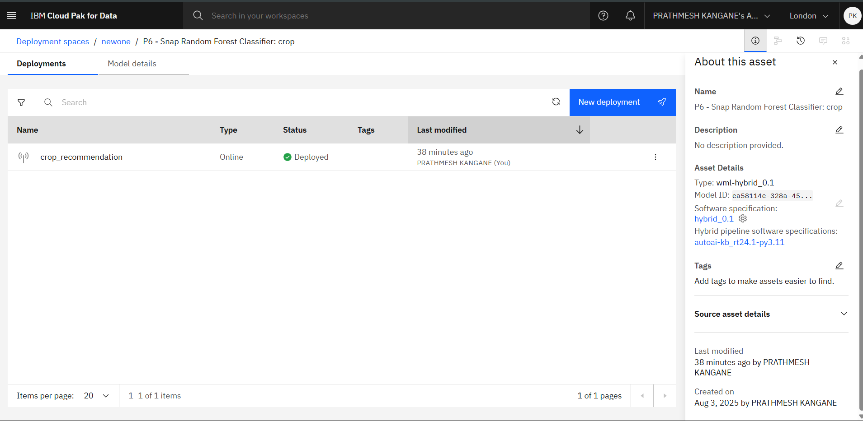
Result
Present the results of the machine learning model in terms of its accuracy and effectiveness in predicting bike counts. Include visualizations and comparisons between predicted and actual counts to highlight the model's performance.

Slide 8
Conclusion
The proposed AI Agent using RAG effectively provides localized, real-time agricultural advice to small-scale farmers. By integrating data from trusted sources and enabling queries in local languages, it supports better farming decisions, improves yield, and increases income.
During implementation, challenges included handling multilingual input, ensuring accurate data retrieval, and maintaining real-time responsiveness. Future improvements may involve expanding language support, enhancing data coverage, and optimizing model performance for rural connectivity.
Overall, the system bridges the knowledge gap in agriculture, promoting smart farming practices at the grassroots level.

Slide 9
Future scope
The system can be enhanced and expanded in several meaningful ways:
Incorporation of Additional Data Sources: Integrating satellite imagery, IoT sensor data, and real-time crop health monitoring can improve the accuracy of farming advice.
Algorithm Optimization: Using advanced machine learning techniques such as reinforcement learning or fine-tuned transformer models can enhance response relevance and speed.
Regional Expansion: The system can be scaled to support farmers across multiple states or countries, with localized data and language support.
Edge Computing Integration: Deploying the model on edge devices can enable real-time processing even in areas with poor internet connectivity.
Smart Alert System: Implement push notifications for weather changes, pest outbreaks, or price updates.
Integration with Government & AgriTech Platforms: Collaborate with public and private entities for broader outreach and more comprehensive data access.

Slide 10
References
Chen, M., Mao, S., & Liu, Y. (2014). Big Data: A Survey. Mobile Networks and Applications, 19(2), 171–209.
Khandelwal, R., & Srinivasan, S. (2021). Smart Farming using Artificial Intelligence: A Systematic Review. Springer, Lecture Notes in Networks and Systems.
Lewis, M., Oguz, B., & Yih, W. (2020). Retrieval-Augmented Generation for Knowledge-Intensive NLP Tasks. https://arxiv.org/abs/2005.11401
Hugging Face. Transformers Library Documentation. https://huggingface.co/docs
LangChain. Documentation on Language Model Orchestration. https://docs.langchain.com
Google. Google Translate API for Language Support. https://cloud.google.com/translate
Ministry of Agriculture & Farmers Welfare, Government of India. https://agricoop.gov.in
Indian Meteorological Department (IMD). Agromet Advisory Services. https://mausam.imd.gov.in

Slide 11
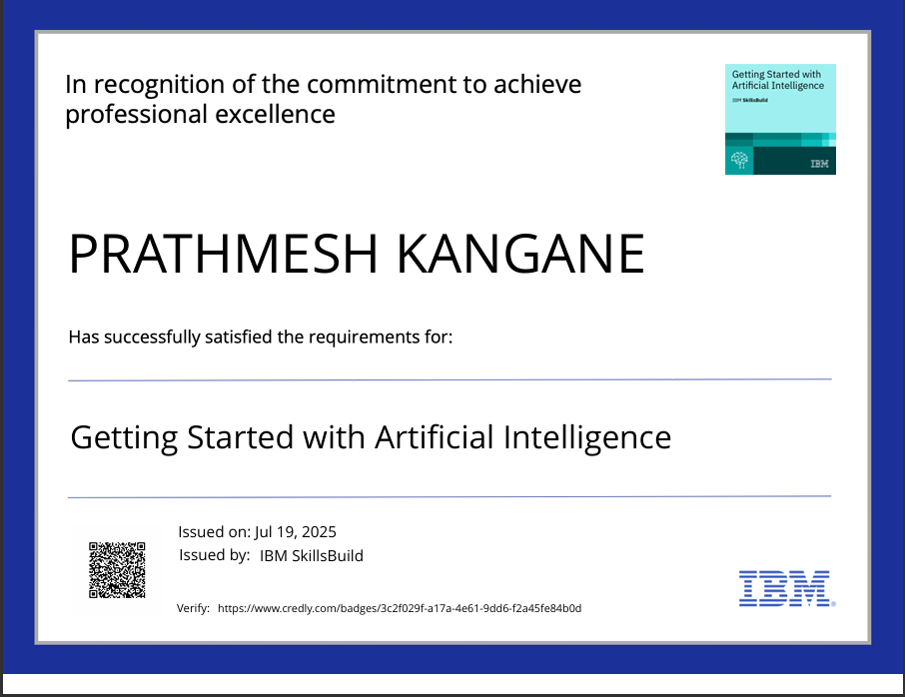
IBM Certifications

Slide 12
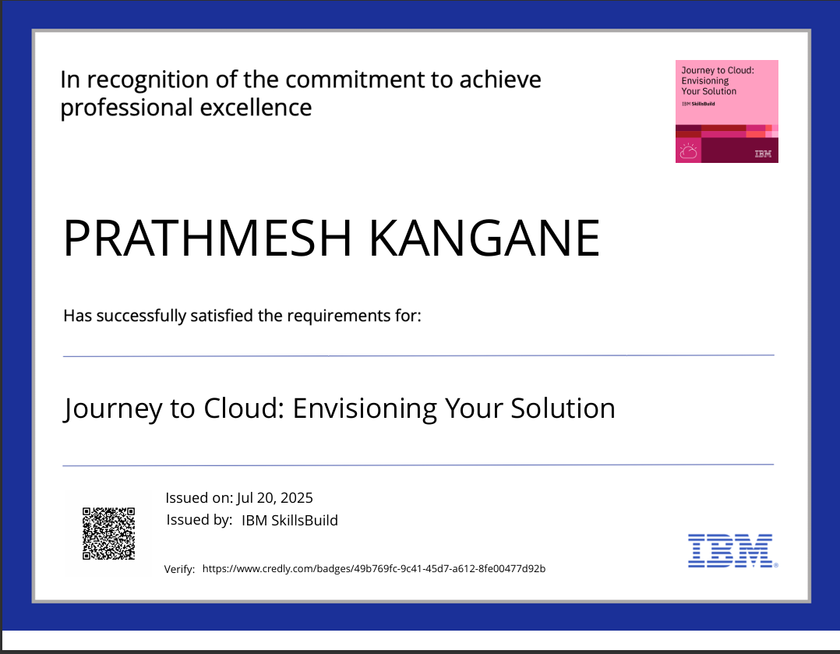
IBM Certifications

Slide 13
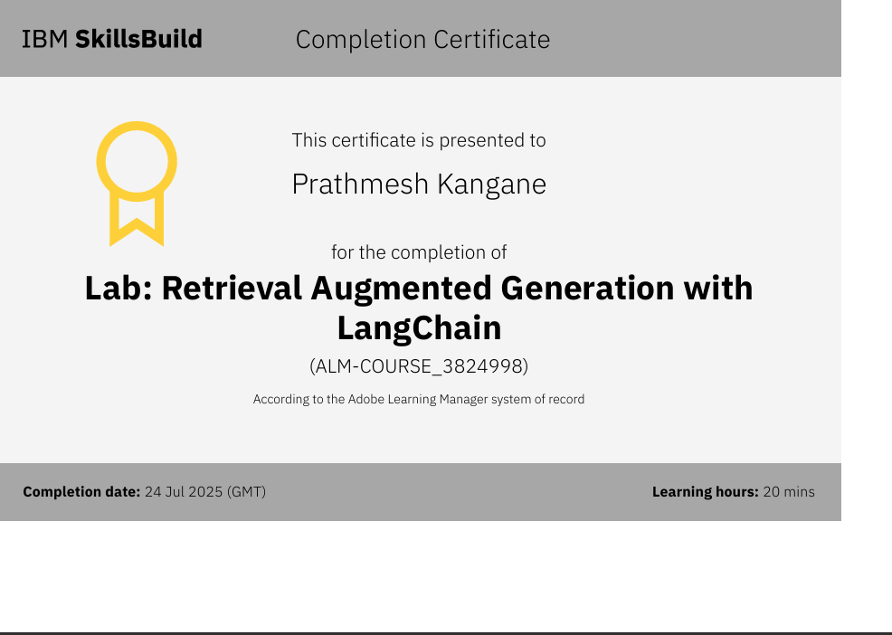
IBM Certifications

Slide 14
THANK YOU

